Slide 1


Dr. Muzamil Ahmed (Assistant Professor) Namal University Mianwali
Natural Language Processing
LLM Generation Parameters

Slide 2

Lesson from Quran

Slide 3

Lecture Outline
How LLMs Generate Text (Autoregressive Decoding)
What are Logits?
Why Generation Parameters Matter
Temperature Parameter
Top-k vs Top-p
Greedy Decoding
Beam Search and Paneities
Parameter Efficient Fine-Tuning (PEFT)
QLoRA: Quantized LoRA

Slide 4
How LLMs Generate Text
Large Language Models generate text using:
Input Prompt
Tokenization
Transformer Forward Pass
Probability Distribution over Vocabulary
Token Selection
Repeat Until Stop Token
Example
Prompt:
“Artificial Intelligence is”
Possible next-token probabilities:
Token | Probability
transforming | 0.42
changing | 0.25
becoming | 0.15
dangerous | 0.05

Slide 5
Autoregressive Decoding
At each step, the model outputs a probability distribution over its entire vocabulary (~32K–100K tokens).
The next token is selected from this distribution, appended to the input, and the process repeats.
This is called autoregressive generation in which each token is conditioned on all previous tokens.
The model predicts one token at a time based on previous context.
Process
Input sequence enters Transformer
Self-attention captures context
Final layer produces logits
Softmax converts logits into probabilities

Slide 6
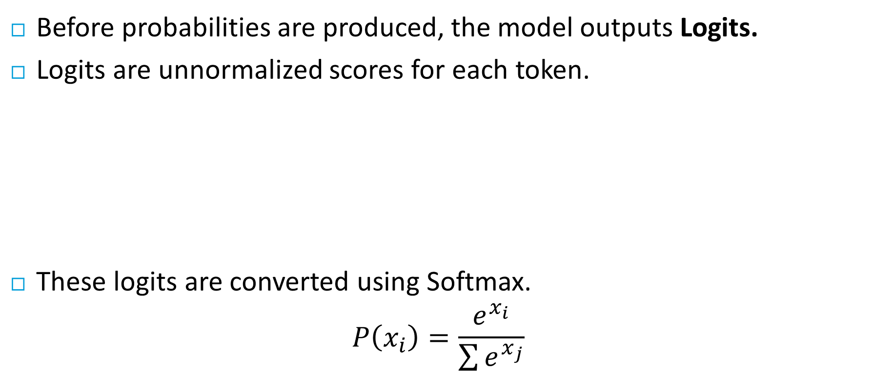
What are Logits?
Before probabilities are produced, the model outputs Logits.
Logits are unnormalized scores for each token.
These logits are converted using Softmax.
$$P\left(x_{i}\right)=\frac{e^{x_{i}}}{\sum{e^{x_{j}}}}$$
Token | Logit
cat | 5.1
dog | 3.2
car | 0.5

Slide 7
Why Generation Parameters Matter
Without proper decoding settings:
Output may become repetitive
Responses may become random
Hallucinations may increase
Creativity may reduce
Responses may become deterministic
Generation parameters control:
Creativity
Diversity
Coherence
Determinism
Stability

Slide 8
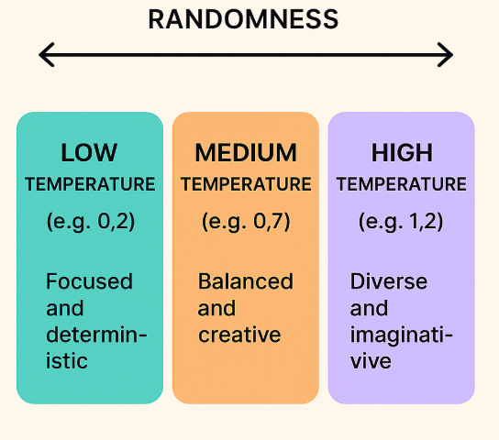
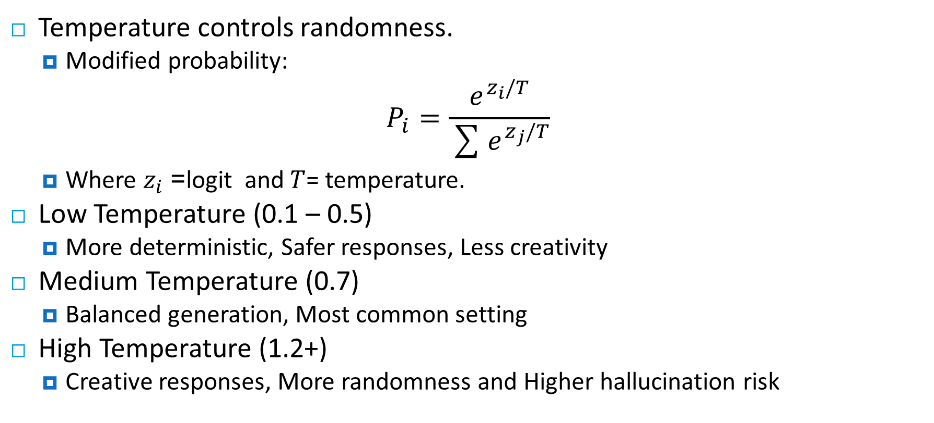
Temperature Parameter
Temperature controls randomness.
Modified probability:
$$P_{i}=\frac{e^{z_{i}/T}}{\sum{e^{z_{j}/T}}}$$
Where $z_{i}$= logit and $T$= temperature.
Low Temperature (0.1 – 0.5)
More deterministic, Safer responses, Less creativity
Medium Temperature (0.7)
Balanced generation, Most common setting
High Temperature (1.2+)
Creative responses, More randomness and Higher hallucination risk

Slide 9
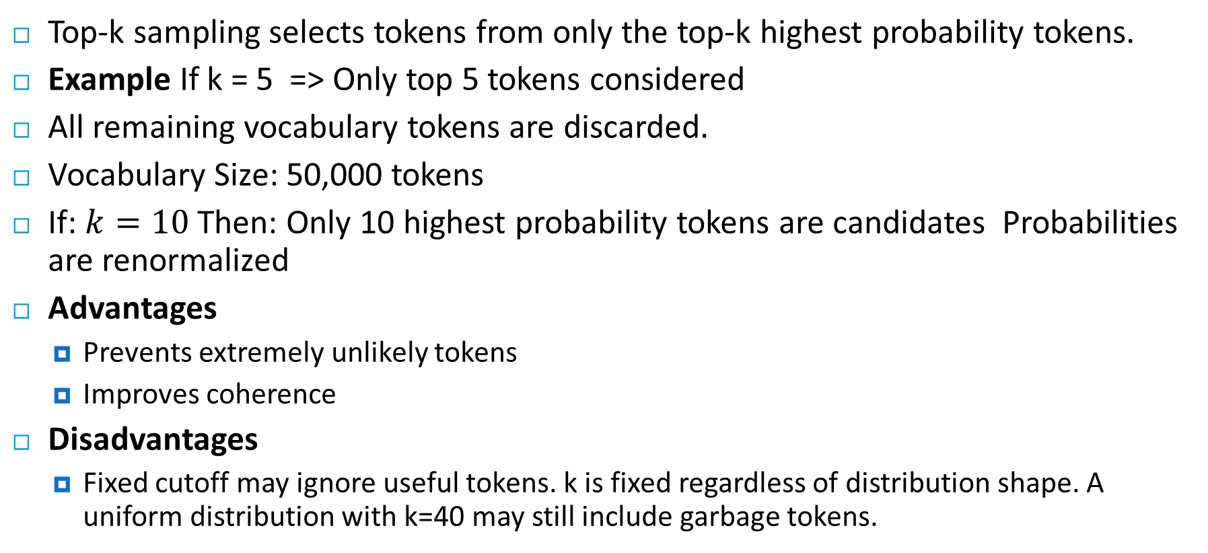
Top-k Sampling
Top-k sampling selects tokens from only the top-k highest probability tokens.
Example If k = 5 => Only top 5 tokens considered
All remaining vocabulary tokens are discarded.
Vocabulary Size: 50,000 tokens
If: $k=10$ Then: Only 10 highest probability tokens are candidates Probabilities are renormalized
Advantages
Prevents extremely unlikely tokens
Improves coherence
Disadvantages
Fixed cutoff may ignore useful tokens. k is fixed regardless of distribution shape. A uniform distribution with k=40 may still include garbage tokens.

Slide 10

Top-p (Nucleus Sampling)
Instead of fixed k tokens:
Top-p selects the smallest set of tokens whose cumulative probability exceeds p.
Example: $p=0.9$, The model dynamically chooses enough tokens to cover 90% probability mass.
Modern LLMs Prefer Top-p sampling, Combined with temperature
Feature | Top-k | Top-p
Token Count | Fixed | Dynamic
Flexibility | Lower | Higher
Creativity | Moderate | Better
Stability | High | Moderate
Common Usage | Older | Modern LLMs

Slide 11
Top-p (Nucleus) & Top-k Sampling
Top-k vs Top-p
Top-k Sampling
Top-p (Nucleus) Sampling
Keep only the k highest probability tokens.
Redistribute probability mass among them.
k = 1 → Greedy (always picks the most likely)
k = 50 → Moderate diversity
k = 500+ → High randomness
Sort tokens by probability. Include tokens until cumulative probability ≥ p.
p = 0.9 → Include top tokens summing to 90%
p = 1.0 → Include all tokens (no filtering)
p = 0.5 → Very conservative selection
⚠ Problem: k is fixed regardless of distribution shape.
A uniform distribution with k=40 may still include garbage tokens.
✓ Adapts dynamically to the distribution.
When model is confident, fewer tokens are considered. More robust than fixed k.
Recommended: p = 0.9, k = 40–50 (often used together)

Slide 12
Greedy Decoding
Greedy decoding selects Highest probability token every time.
Characteristics
Deterministic
Fast
Often repetitive
Can miss better sequences
Example
Prompt:
“I enjoy”
Greedy Output:
“I enjoy playing football every day every day every day…”

Slide 13
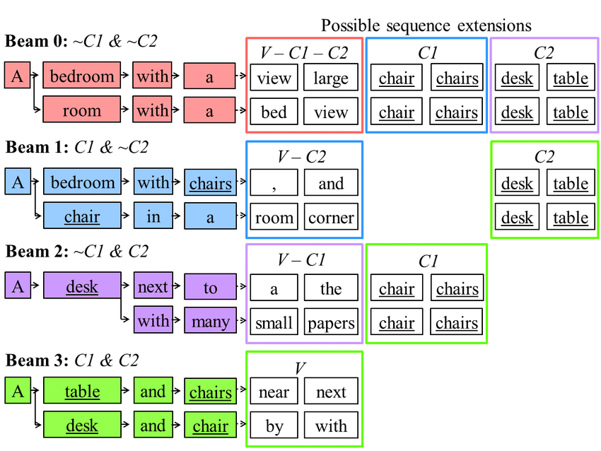
Beam Search
Beam Search keeps multiple candidate sequences.
Beam Search Workflow
Generate multiple candidates
Score sequences
Retain best beams
Expand beams
Continue until completion
Advantages
Better sequence quality, Stronger coherence
Disadvantages
Computationally expensive, Reduced diversity

Slide 14
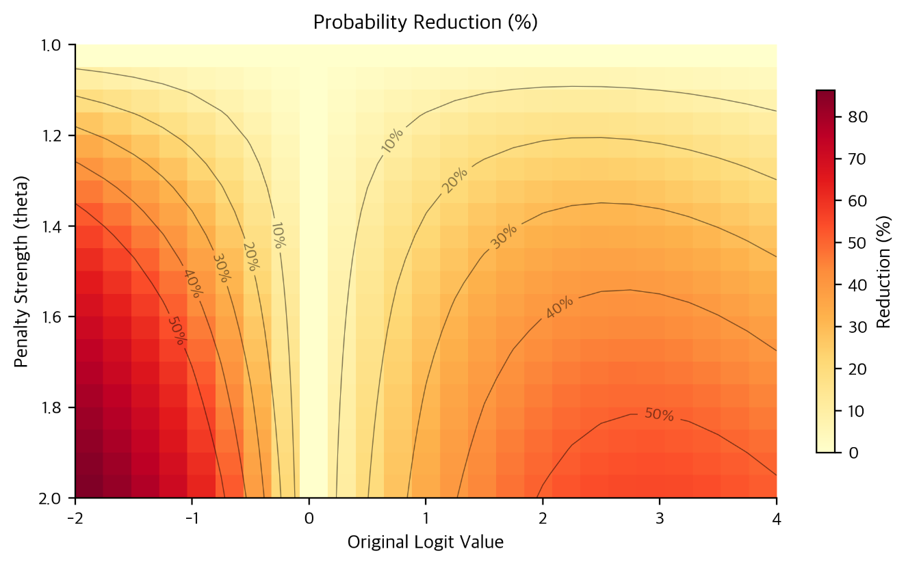
Repetition Penalty
LLMs may repeat phrases excessively.
Repetition Penalty
Reduces probability of previously generated tokens.
Typical values:
1.0 → No penalty
1.1 → Mild penalty
1.5 → Strong penalty
Goal
Prevent loops
Improve readability
Increase diversity

Slide 15
Frequency & Presence Penalties
Frequency Penalty
Penalizes tokens repeated many times.
Presence Penalty
Penalizes tokens appearing at least once.
Applications
Chatbots
Story generation
Long-form text generation

Slide 16
Other Key Generation Parameters
Max New Tokens
Stop Sequences
max_new_tokens=256
stop=["\n\n", "<|end|>"]
Limits the length of generated output. Essential for preventing runaway generation and controlling costs. Set based on expected output length.
Halts generation when specified token sequences are encountered. Critical for structured outputs, preventing overly long responses.
Typical range: 50–4096 depending on task
Always set for chat/instruction models

Slide 17
Typical Generation Configuration
generation_config = { "temperature": 0.7, "top_p": 0.9, "top_k": 50, "max_tokens": 256, "repetition_penalty": 1.1 }
Interpretation
Balanced creativity
Controlled randomness
Reduced repetition

Slide 18
Problems with Full Fine-Tuning
Large LLMs contain billions of parameters.
Example: 7B parameters, 13B parameters, 70B parameters
Challenges
Massive GPU memory requirements
High training cost
Slow training
Storage overhead
Multiple task-specific copies
175B
8×
$1M+
GPT-3 Parameters
Memory for Training
Full Fine-Tune Cost
each stored as FP32 = ~700GB VRAM
weights + gradients + optimizer state
for large foundation models

Slide 19
Parameter Efficient Fine-Tuning (PEFT)
PEFT techniques train only a small subset of parameters.
Advantages
Lower GPU memory
Faster training
Smaller checkpoints
Easier deployment
Popular PEFT Methods
Prompt Tuning
Prefix Tuning
Adapters
LoRA
QLoRA

Slide 20
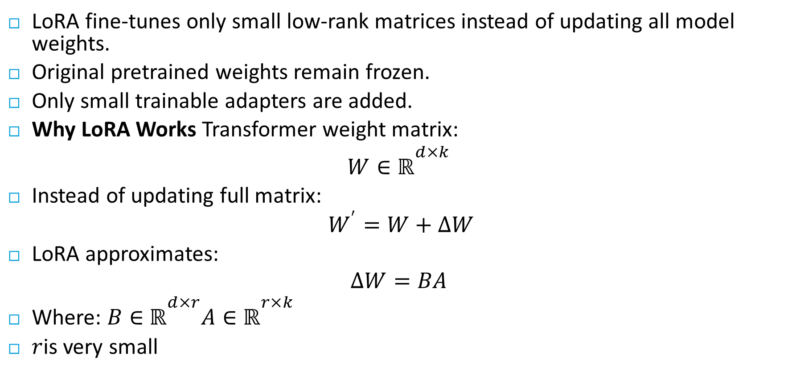
LoRA = Low-Rank Adaptation
LoRA fine-tunes only small low-rank matrices instead of updating all model weights.
Original pretrained weights remain frozen.
Only small trainable adapters are added.
Why LoRA Works Transformer weight matrix:
$$W∈ℝ^{d×k}$$
Instead of updating full matrix:
$W^{′}=W+ΔW$
LoRA approximates:
$$ΔW=BA$$
Where: $B∈ℝ^{d×r}A∈ℝ^{r×k}$
$r$is very small

Slide 21
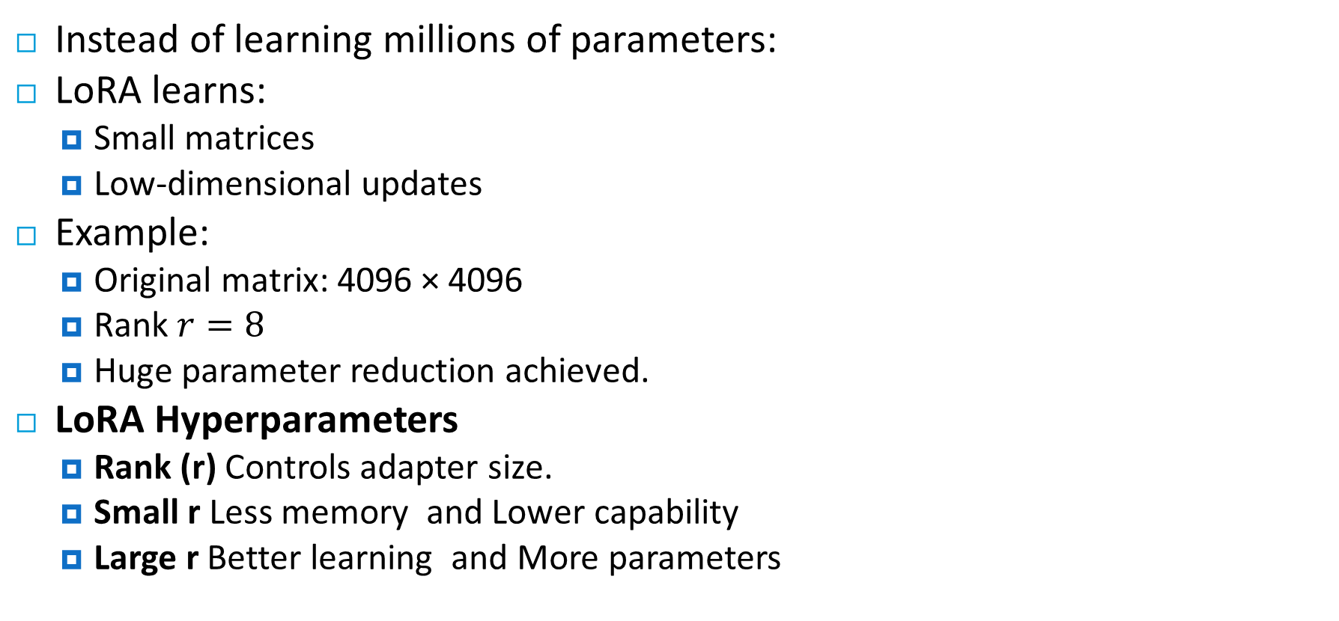
Understanding Low Rank
Instead of learning millions of parameters:
LoRA learns:
Small matrices
Low-dimensional updates
Example:
Original matrix: 4096 × 4096
Rank $r=8$
Huge parameter reduction achieved.
LoRA Hyperparameters
Rank (r) Controls adapter size.
Small r Less memory and Lower capability
Large r Better learning and More parameters

Slide 22
QLoRA: Quantized LoRA
QLoRA (Dettmers et al., 2023) combines 4-bit quantization of the base model with LoRA adapters in BF16 and Enable fine-tuning of 65B models on a single 48GB GPU.
NF4 Quantization
Normal Float 4 (NF4) is a 4-bit data type optimized for normally distributed weights. Each weight stored in 4 bits instead of 16 or 32 — 4× to 8× memory reduction.
Double Quantization
Quantize the quantization constants themselves. Saves ~0.37 bits per parameter — small individually but significant at billions of parameters.
Paged Optimizers
Uses NVIDIA unified memory to page optimizer states to CPU RAM during gradient checkpointing spikes, preventing out-of-memory crashes.
Notes:
Memory Comparison: 7B Model — Full FP16: ~14GB | LoRA FP16: ~14GB base + adapters | QLoRA 4-bit: ~4–5GB total ✓

Slide 23

Thanks

